Slide 1
USEFUL JAPANESE DICTIONARY FOR VIETNAMESE
Supervisor: Nguyễn Văn Sang
Lê Đình Nam se02316
Phạm Thị Minh se02300
Phạm Tiến Đạt se02336
Nguyễn Ngọc Tuấn se02189

Slide 2
Problem Definition
The Idea
System purpose/ objective
Requirements
Functionalities

Slide 3
Problem Definition
Demand of learning Japanese high
Learning online
Nowadays, the relation of Vietnam and Japan is very good, Japan market need more human resource of Vietnam in many fields, special IT.
Have a lot of Japanese training center
With technology development, there are many websites to learn Japanese with many types and languages. Moreover it requests user upgrade account to learn.
Because number of people learn Japanese is crowd, series of centers are opened but they cannot control of training quality.

Slide 4
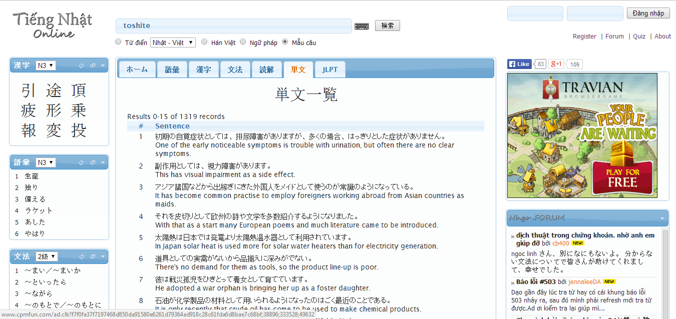
Problem Definition
With purpose is save time, many users choose study online likes a best way. But nowadays, have not website really good for Vietnamese.
Search with more option, but more words have not meaning with Vietnamese
Search Kanji, grammar
Post question
Do not support Viet-Nhat dictionary
Do not support listening, reading, conservation …

Slide 5
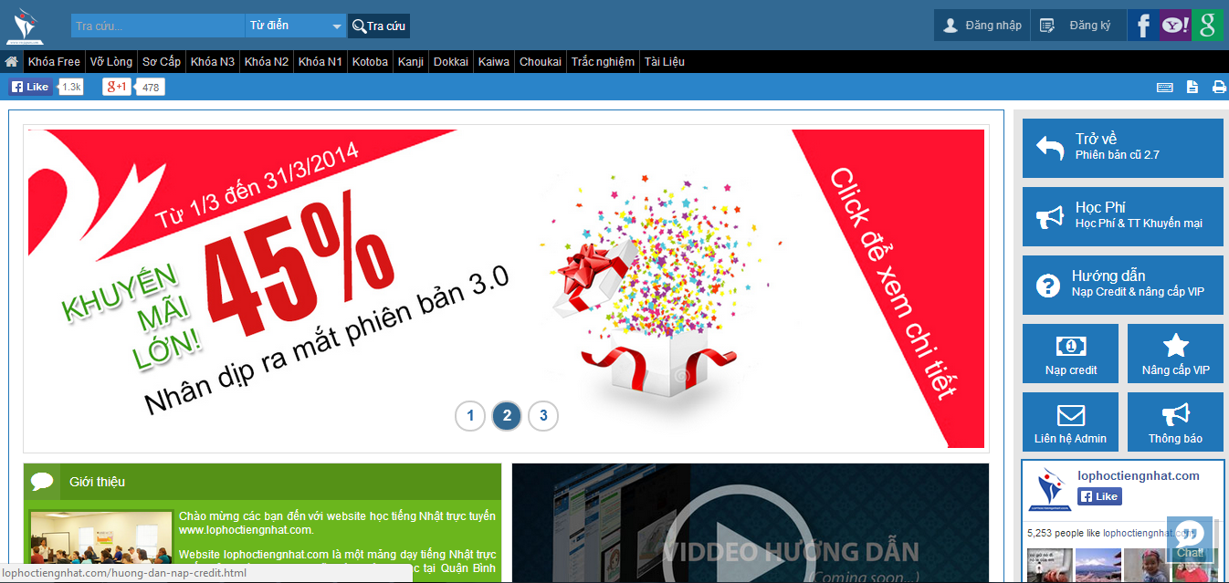
Problem Definition
Full support with listening, reading, conservation
Support search but too simple
Have to register and upgrade account to study

Slide 6



The idea
Reducing above gaps and integrating important function to help user by a best way. UJD_VN will bring to user:
User only need a laptop connect to internet, use any browser to access website
Friendly interface, easy to use by Vietnamese language
User have not to mind about upgrading account to study

Slide 7


The idea
Full of sections to user can choose, such as: reading, listening, conservation, video, testing, review JLPT…
Specially, search function with full option to help user maximum
User can contribute opinion and data

Slide 8


Objectives
To meet requirements from FPT University, we have to complete this project, it is conditional for us to graduate.
Applying knowledge during in 4 years to complete project successfully
Studying more about: Java script, PHP, HTML, …

Slide 9
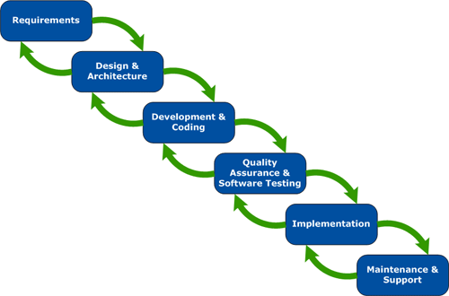


Objectives
Understanding of software development process of F-soft
Learning manage project and time
Improving soft skill and working in group

Slide 10
Functional Requirements
The system will be developed on web
User include guest and member can use functions likes:
User can filter and searching words with more options:
Search sentences: User enter 1 word then choose option ‘Search sentence’ , website will return full meaning of word and list related example sentences.
Search grammar: User enter 1 grammar then choose option ‘Search grammar’ , website will return full meaning of grammar and list related example sentences.

Slide 11
Functional Requirements
Search conversation: User enter 1 keyword relate conversation then choose option ‘ Search conversation’, website will return list related conversations
Search specialized Japanese: User enter 1 word then choose option ‘ Search specialized Japanese’, website website will return full meaning of word and list related example sentences.
Search video: User enter 1 keyword relate video then choose option ‘ Search video’, website will return list related videos.

Slide 12
Functional Requirements
User can learn with many sections:
Training listening: User can choose section depend on level (N2, N3, N4)
Training reading: User can choose section from easy to hard
Reading document: website provide lots of documnet such as foundamentel japanese, intermediate japanese, review
Listening conversation: User can choose section ‘daily conversation’, ‘common conversation’
User can contribute database or opinion: when user has good document and good idea, user can send to admin

Slide 13
Functional Requirements
If user is member, they can do test depend on level, in each level have full section to member test: reading, listening, garmmar, vocabulary. When member finishs test, they can save mark to tracking.
Member can manage their account: edit profile, track mark
Member can log in by registered account or by facebook account / google account
If member forget password, they can get new password

Slide 14
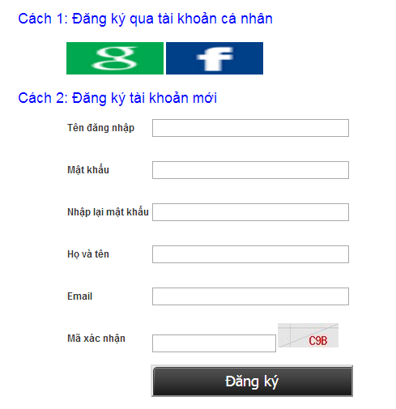
Functional Requirements
If user is guest, they have to register then doing test and tracking mark in manage account

Slide 15
Functional Requirements
Admin can manage admin’s account: admin can ad new admin, edit profile, delete admin
Admin can manage member’s account: search member, ban/unban member, delete member
Admin can manage Q&A: search Q&A, reply Q&A, delete Q&A, Approve Q&A
Admin can manage database of: Vocabulary, reading, listening, conversation, testing. In each database, admin can search, add, edit, delete

Slide 16
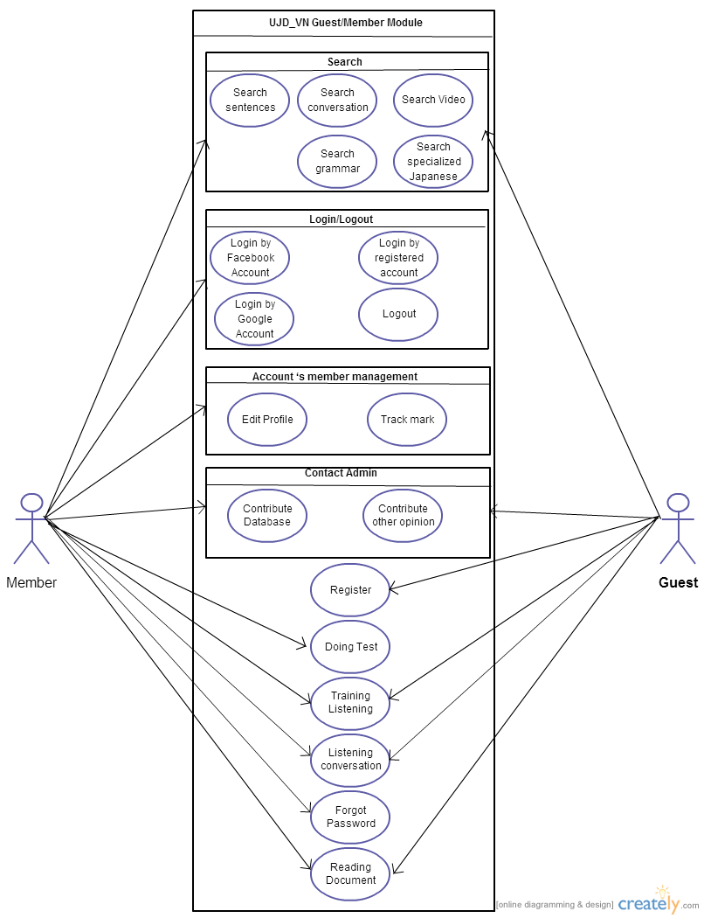
Use cases diagram

Slide 17
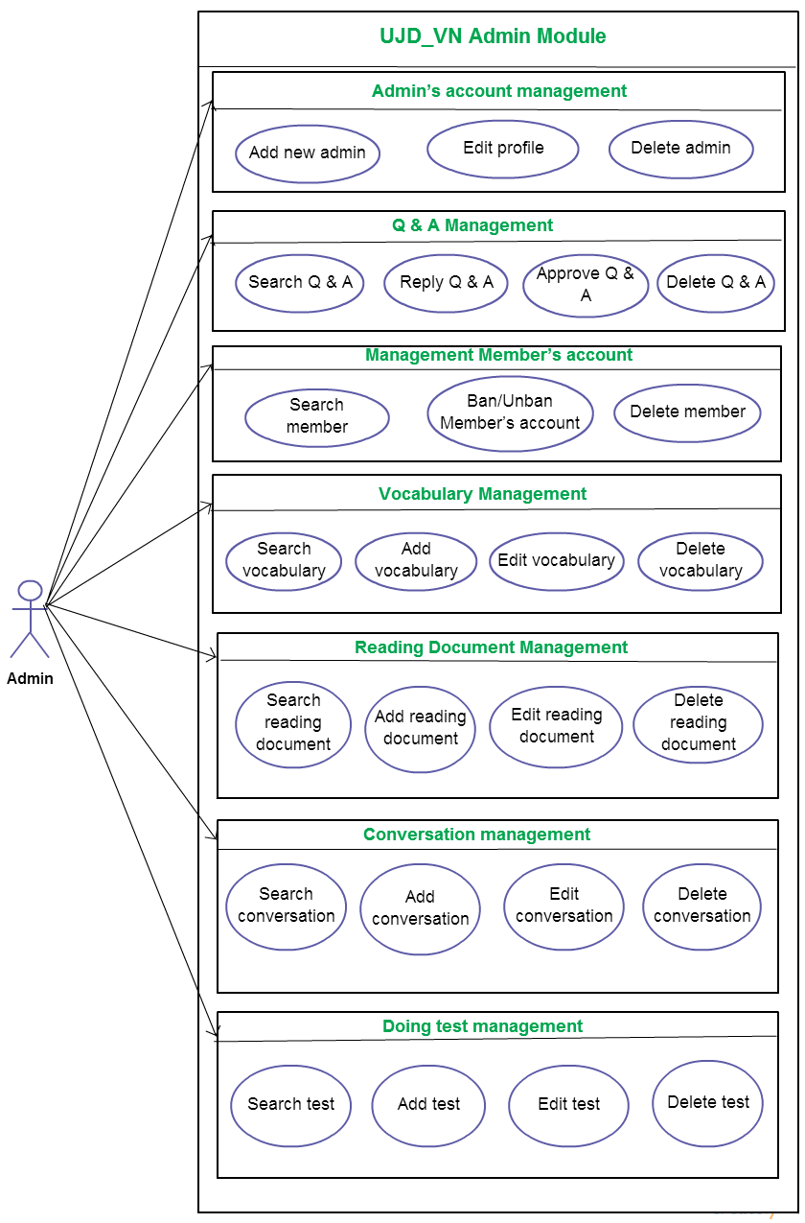

Slide 18
Non-Functional Requirements
Performance: time to response, time of processing.
Availability: hours of operation
Maintainability: architectural standards, coding standards.
Usability: friendly, interactive.
Capacity and scalability: throughput, storage and growth requirements.

Slide 19


